Slide 1
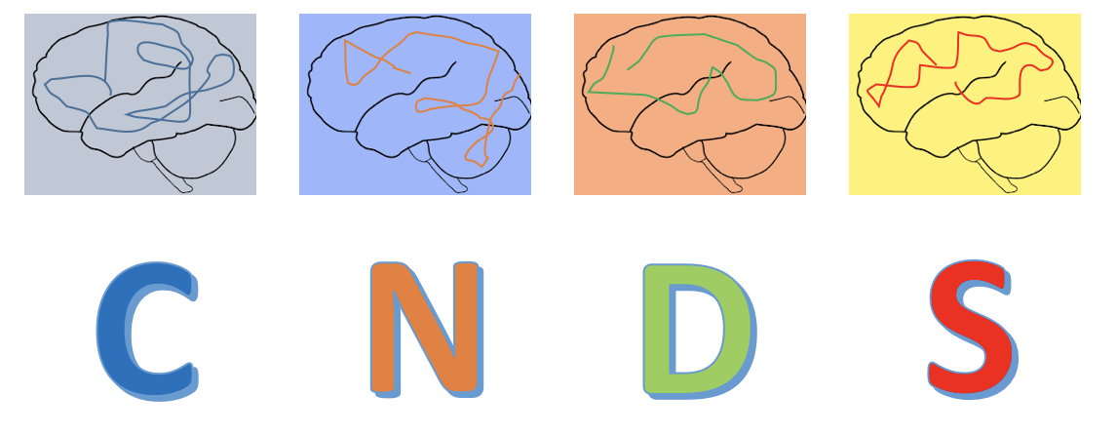
Baby sasquatch January 9th 2019
Romain Duprat

Slide 2
Baby sasquatch 9th January 2019
Localizing the DLPFC using MNI coordinates
Segmentation
Transformation
Neuronavigation

Slide 3
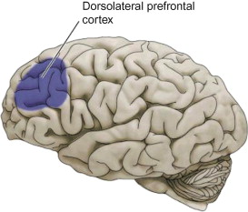
What is the goal
To have a reliable and easily replicable localization of the DLPFC
Visual identification requires more training / remains subjective
Functional localization is probably better but too time consuming
To use the method with the most optimal time/precision ratio
DLPFC from template brain ➔MNI

Slide 4
ANTSct
Pass T1 image through antscorticalthickness (check wrapper at /data/jag/cnds/seda/antsct_resting, template: OASIS)
ANTSct script can be adapted to your files structure
Requires 12h to run completely
Give yourself at least 24h for that step in case something goes wrong

Slide 5
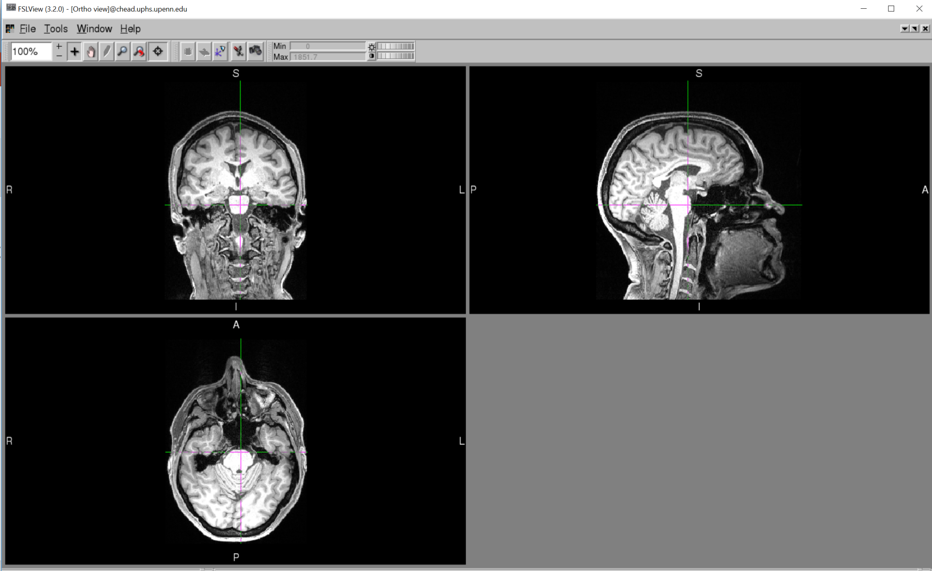
For example:
Subject T1

Slide 6
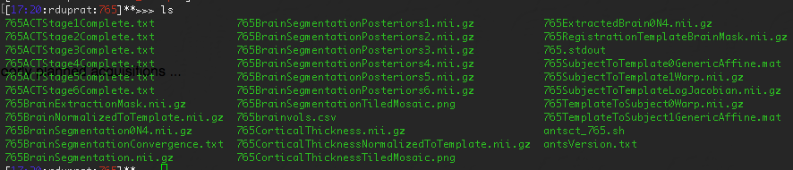
Transformation
ANTSct output:

Slide 7

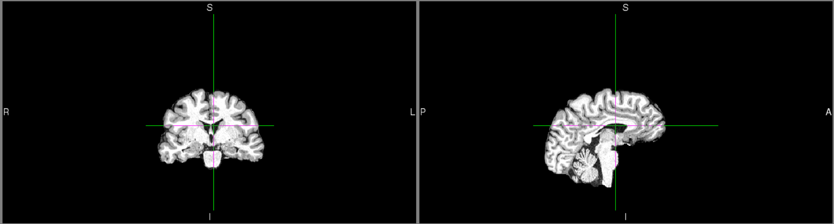
For example:

Slide 8
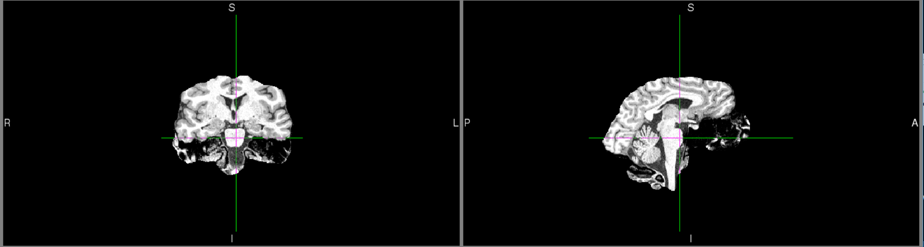
For example:

Slide 9
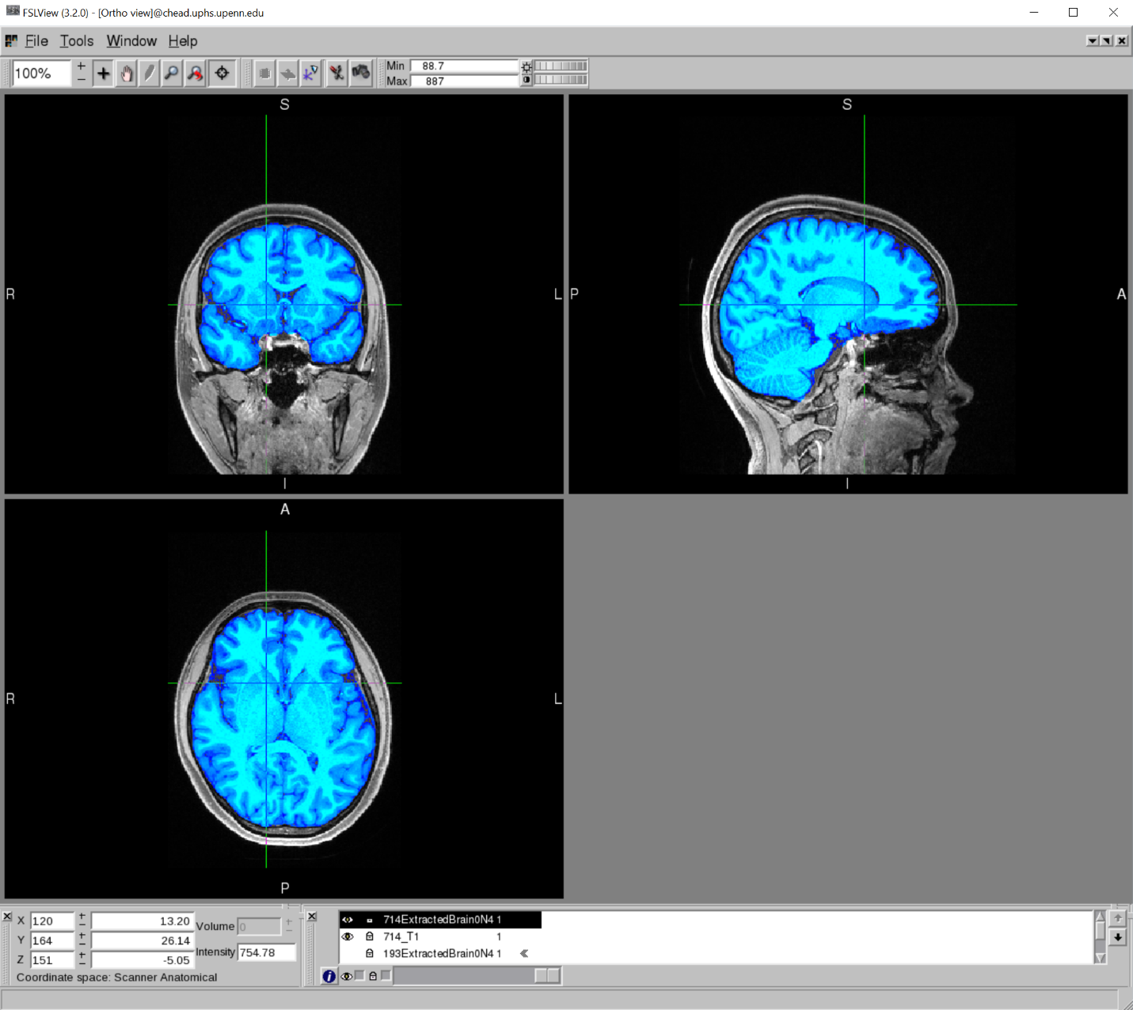
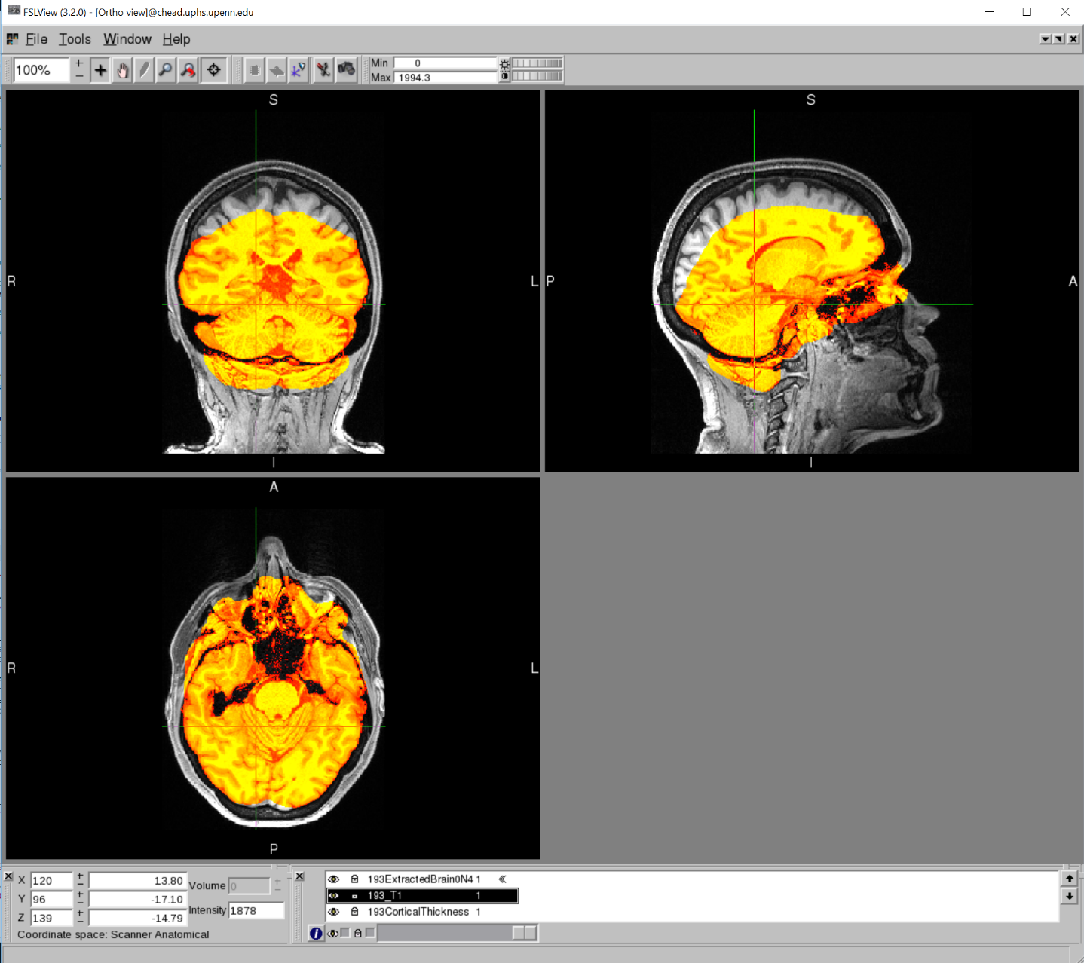

Slide 10
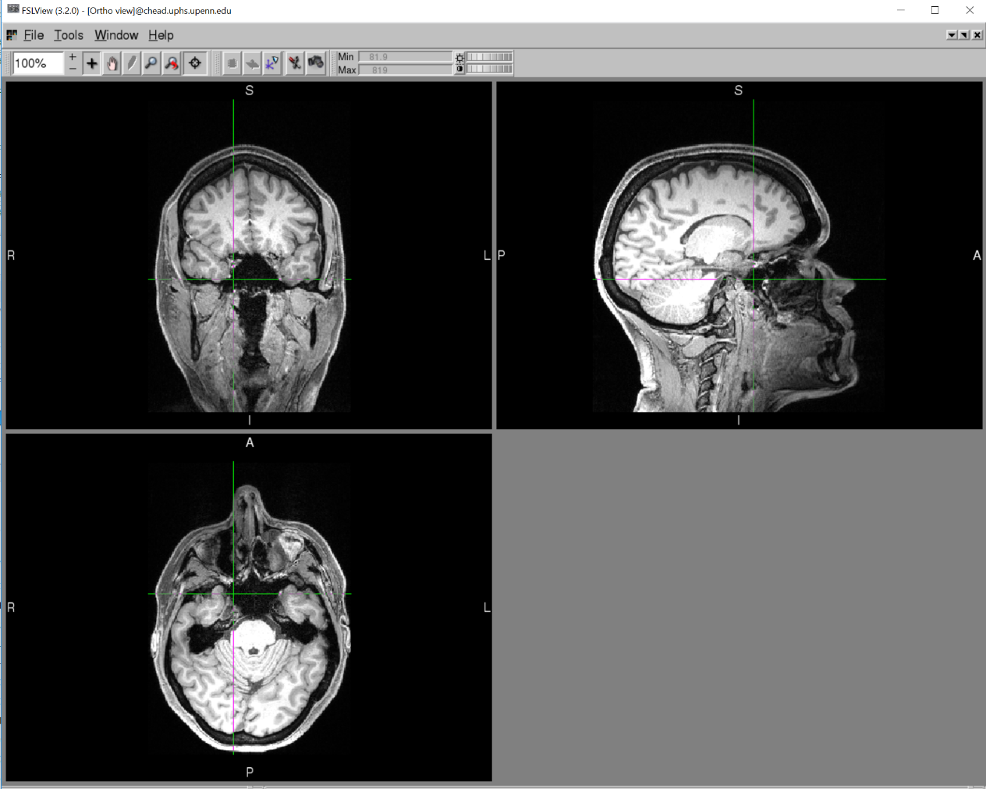
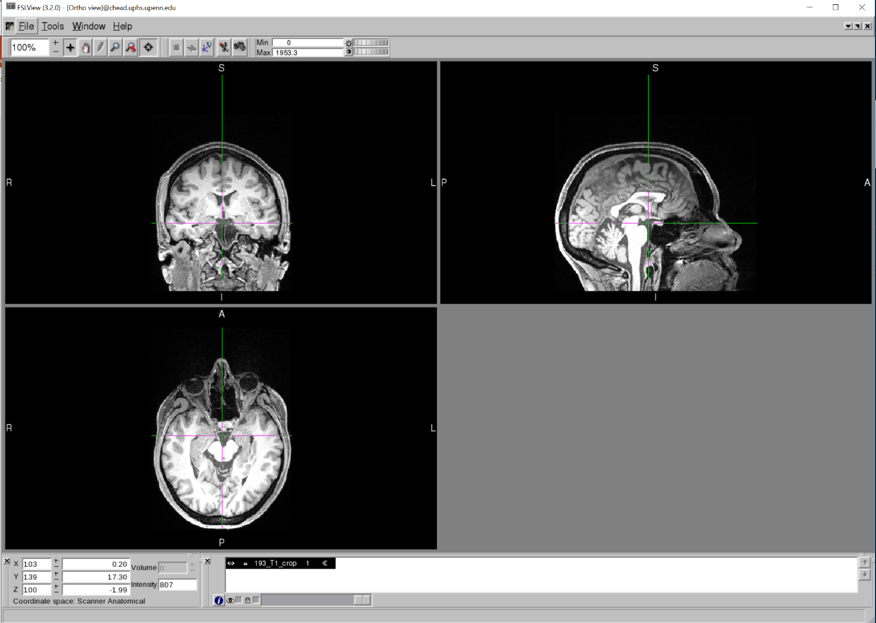
Simple fix: need to crop T1
fslroi
To crop ➔ fslroi <input> <output> <xmin> <xsize> <ymin> <ysize> <zmin> <zsize>
To know x, y and z size ➔ use the dimensions given by fslinfo on your T1

Slide 11
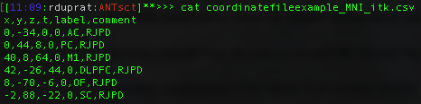
antsApplyTransformsToPoints
Prepare coordinate file:
Input csv file: coordinatefileexample_MNI_itk.csv
Whats itk?
Different space used by dependencies of ANTS
X and Y axis are inverted
Need to change sign of x and y coordinates before transformation

Slide 12
antsApplyTransformsToPoints
Prepare coordinate file:
Input csv file: coordinatefileexample_MNI_itk.csv
Whats itk?
Different space used by dependencies of ANTS
X and Y axis are inverted
Need to change sign of x and y coordinates before transformation

Slide 13
Affine and warp files
MNI
OASIS
Native

Slide 14
Affine and warp files
We take the opposite of transformation direction
MNI
OASIS
Native
OASIS2MNI_0GenericAffine.mat
735SubjectToTemplate0GenericAffine.mat
OASIS2MNI_1Warp.nii.gz
735SubjectToTemplate1Warp.nii.gz

Slide 15
Affine and warp files
We take the opposite of transformation direction
MNI
OASIS
Native
OASIS2MNI_0GenericAffine.mat
735SubjectToTemplate0GenericAffine.mat
OASIS2MNI_1Warp.nii.gz
735SubjectToTemplate1Warp.nii.gz
But keep order of use (0 and 1)
735SubjectToTemplate0GenericAffine.mat
735SubjectToTemplate1Warp.nii.gz
OASIS2MNI_0GenericAffine.mat
OASIS2MNI_1Warp.nii.gz
antsApplyTransformsToPoints -d 3 -i coordinatefileexample_MNI_itk.csv -o coordinatefileexample_native_itk.csvv -t /data/jag/cnds/romain/xcp_06/Warp_OASIS2MNI/0GenericAffine.mat -t /data/jag/cnds/romain/xcp_06/Warp_OASIS2MNI/1Warp.nii.gz -t 735SubjectToTemplate0GenericAffine.mat -t 735SubjectToTemplate1Warp.nii.gz

Slide 16
antsApplyTransformsToPoints
antsApplyTransformsToPoints
-d 3
-i coordinatefileexample_MNI_itk.csv
-o coordinatefileexample_native_itk.csvv
-t /data/jag/cnds/romain/xcp_06/Warp_OASIS2MNI/0GenericAffine.mat
-t /data/jag/cnds/romain/xcp_06/Warp_OASIS2MNI/1Warp.nii.gz
-t 735SubjectToTemplate0GenericAffine.mat
-t 735SubjectToTemplate1Warp.nii.gz

Slide 17
Transformation
ANTSct output:

Slide 18
Transformation
ANTSct output:

Slide 19
antsApplyTransformsToPoints
antsApplyTransformsToPoints
-d 3
-i coordinatefileexample_MNI_itk.csv
-o coordinatefileexample_native_itk.csv
-t /data/jag/cnds/romain/xcp_06/Warp_OASIS2MNI/0GenericAffine.mat
-t /data/jag/cnds/romain/xcp_06/Warp_OASIS2MNI/1Warp.nii.gz
-t 735SubjectToTemplate0GenericAffine.mat
-t 735SubjectToTemplate1Warp.nii.gz

Slide 20
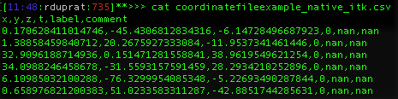
Transformation
Input:coordinatefileexample_MNI_itk.csv
Output: coordinatefileexample_native_itk.csv

Slide 21
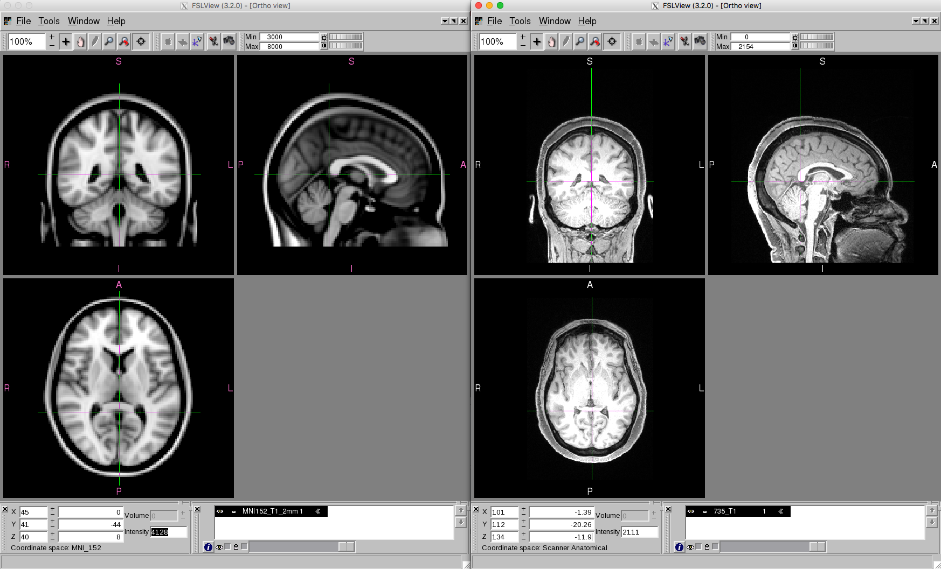
fslview 735_T1.nii.gz & fslview MNI152_T1_2mm.nii.gz &

Slide 22
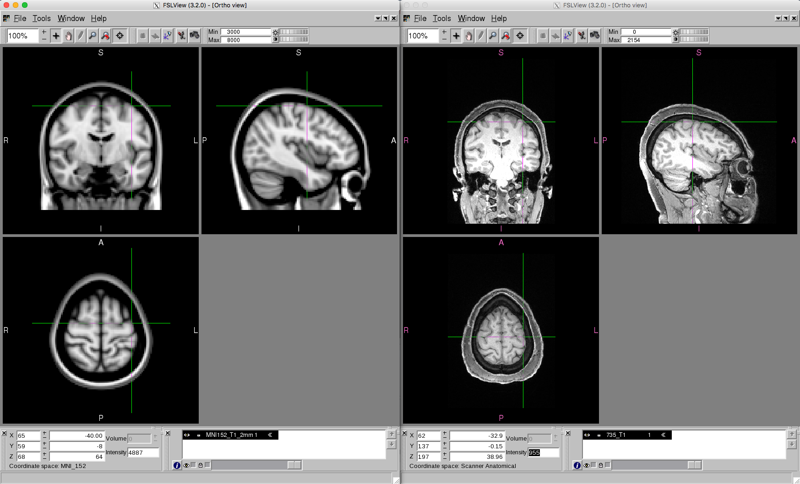
fslview 735_T1.nii.gz & fslview MNI152_T1_2mm.nii.gz &

Slide 23
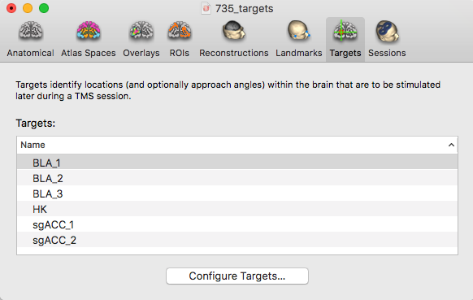
Neuronavigation

Slide 24
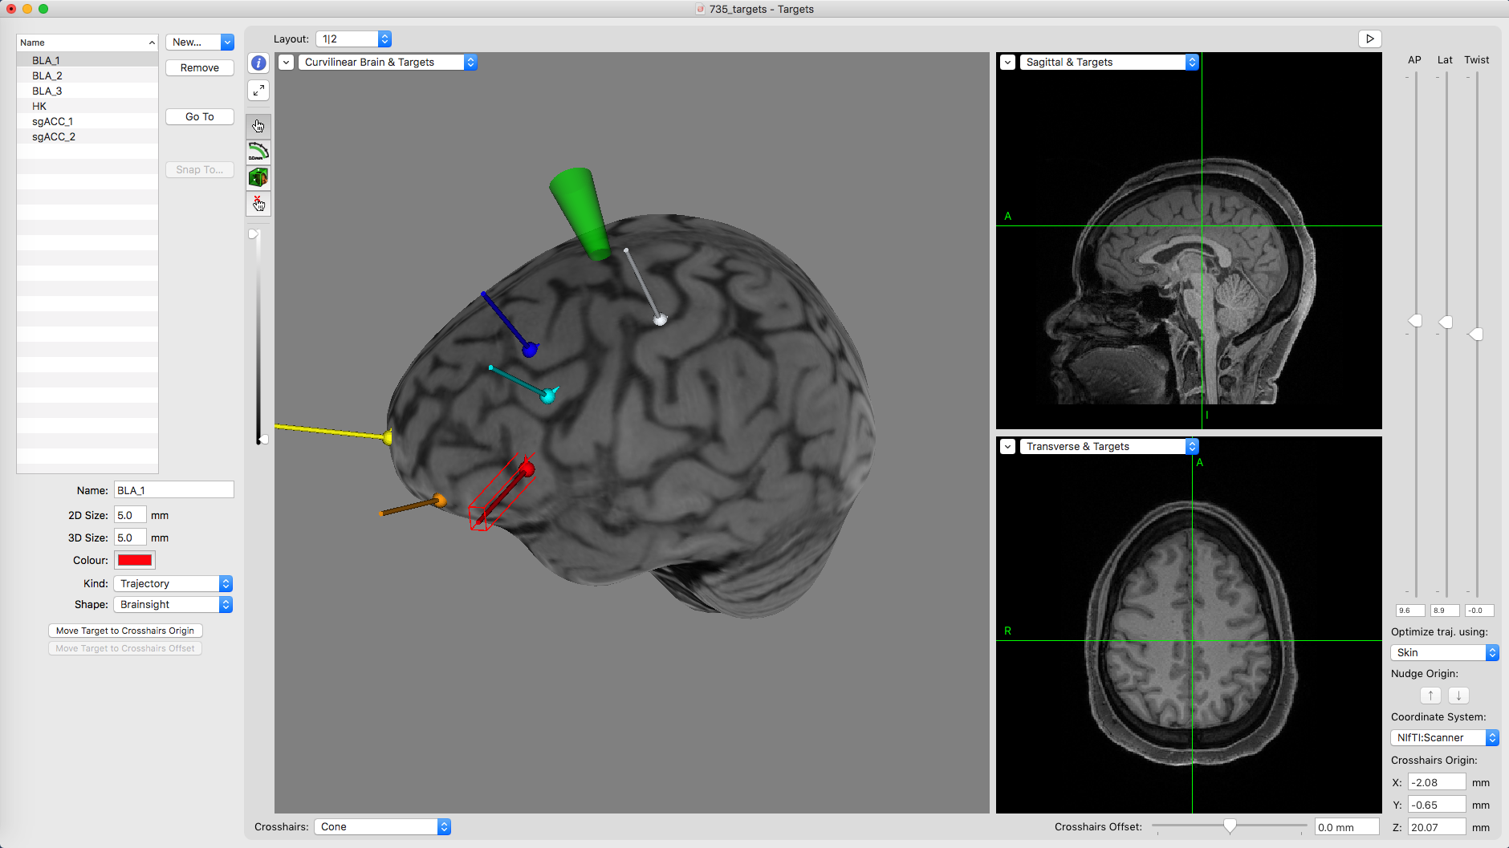
Neuronavigation

Slide 25
Neuronavigation

Slide 26
Neuronavigation
Create new TRAJECTORY

Slide 27
Thank you
Find the slides on: https://github.com/djo155/babySASQUATCH

